Slide 1


CSB4301 – Theory of Computation
B.Tech – IVth Semester
Mr. D.S.John Deva Prasanna AP(SG) & Ms.Vanathi, AP,CSE
Department of Computer Science and Engineering

Slide 2
Non Deterministic Finite Automata -NFA
NFA is very same as DFA except the following differences.
NFA states can have more than one transition for any input symbol.
Transitions for every input symbol from every state of the automaton is not defined.
Any language that is recognized by a DFA can be recognized by NFA too.
NFA is easier to design than DFA.

Slide 3
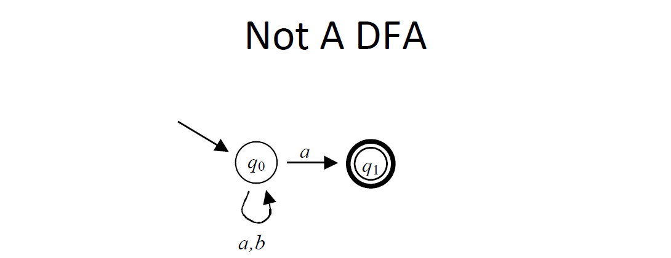
A sample NFA
Note:
There are two transitions for the symbol ‘a’ from state q0.
There is no transition defined from the state q1.
The above two conditions cannot be seen in a DFA.

Slide 4
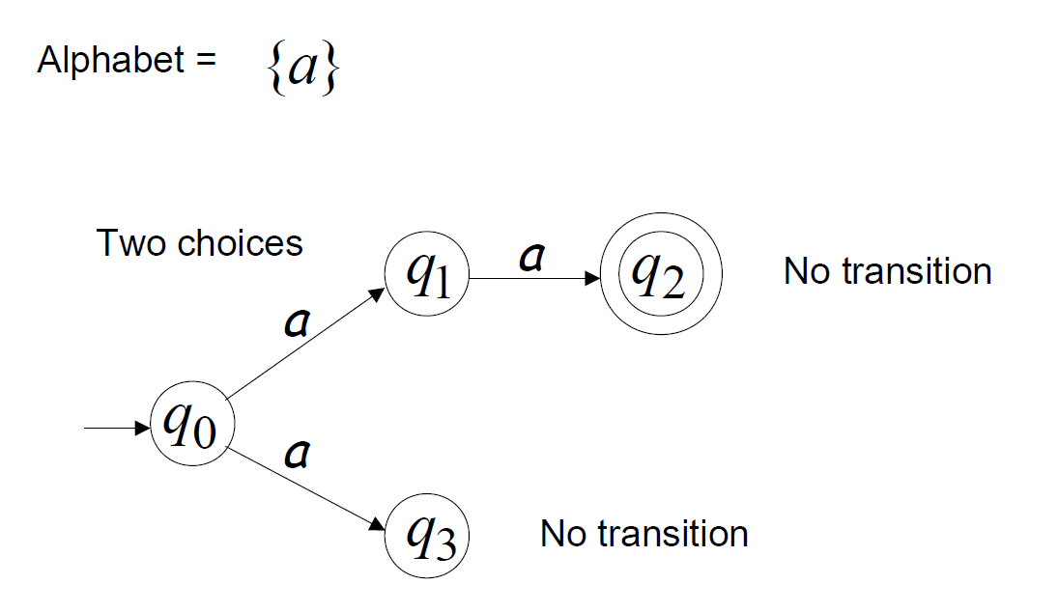
NFA - Sample

Slide 5
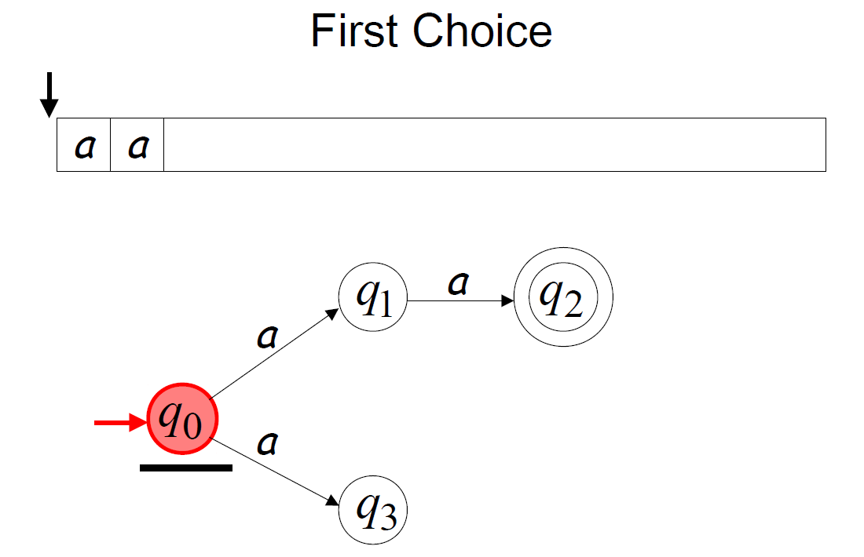
Transitions on a NFA

Slide 6
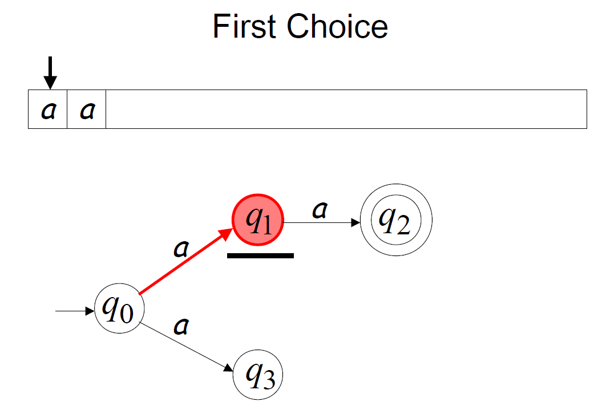
NFA Transitions

Slide 7
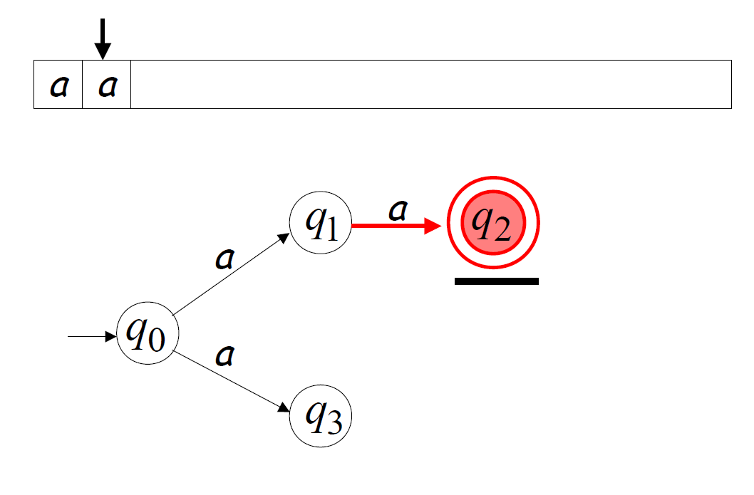
NFA Transition

Slide 8
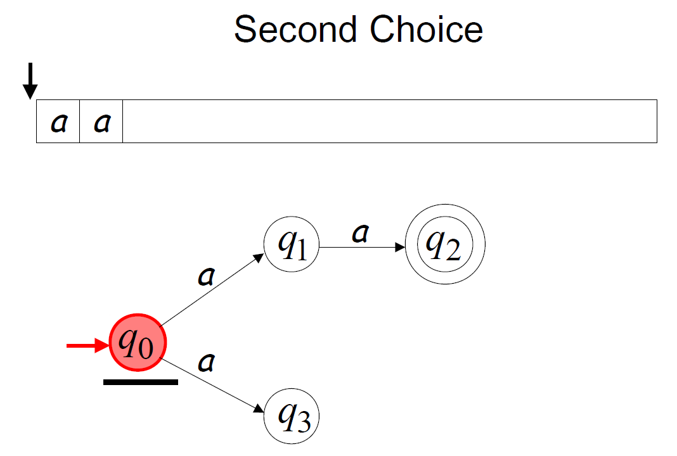
NFA Transition

Slide 9
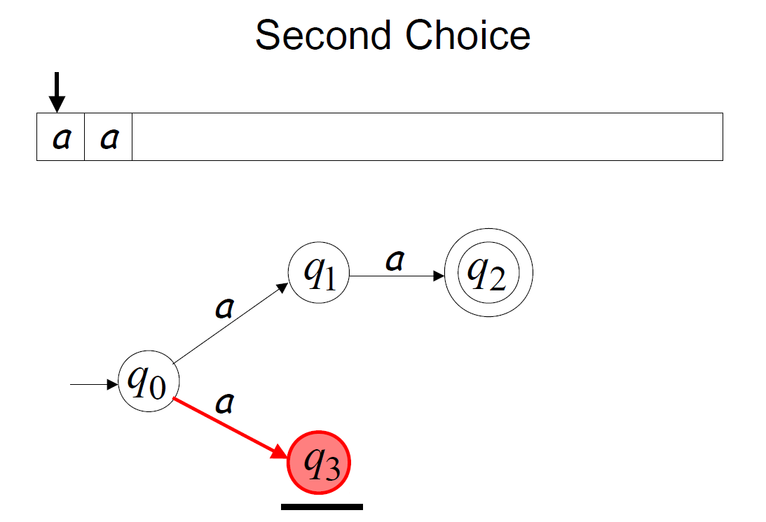
NFA Transition

Slide 10
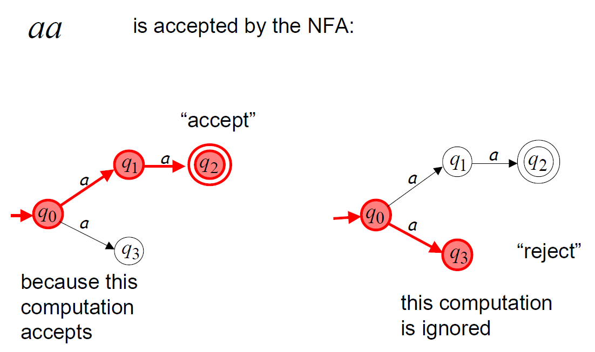
NFA – Computations

Slide 11
NFA – Accepting Strings
A NFA is said to accept a string ‘w’, then it means that NFA has started transition at starting state q₀ and after scanning all input symbols reaches any one of the accepting states F={ ...}

Slide 12
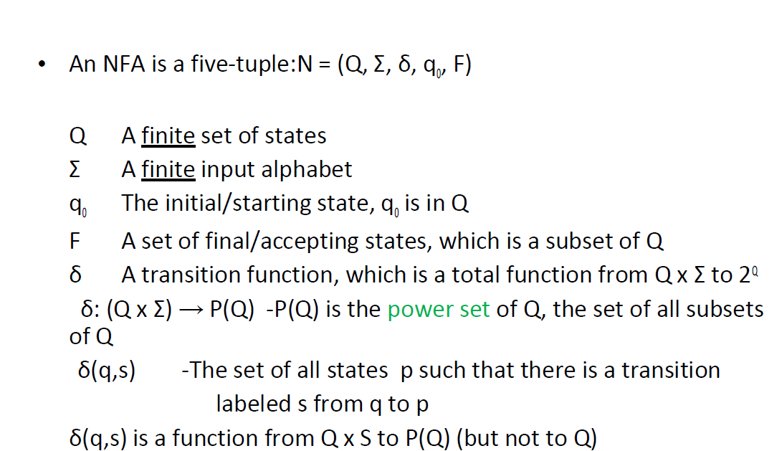
Formal Representation of NFA (observe the ‘δ’ function)

Slide 13
What is a power set of ‘s’?
Power set of any set ‘S’ will contain all the subset in ‘S’ including empty set.
For example
P({1,2,3}) = {{},{1},{2},{3},{12},{13},{23},{1,2,3}}
Here in NFA the transition function ‘δ’ will return a set of states instead of one state,

Slide 14
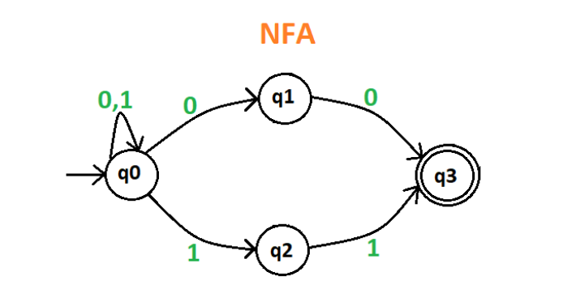
NFA Transitions
Transition Table of the NFA
 | 0 | 1
q0 | {q0,q1} | {q0,q2}
q1 | {q3} | {}
q2 | {} | {q3}
q3 | {} | {}
Note:
The NFA transitions has subset of states(combinations of states) as output instead of a single state, including the empty sets for undefined transitions.

Slide 15
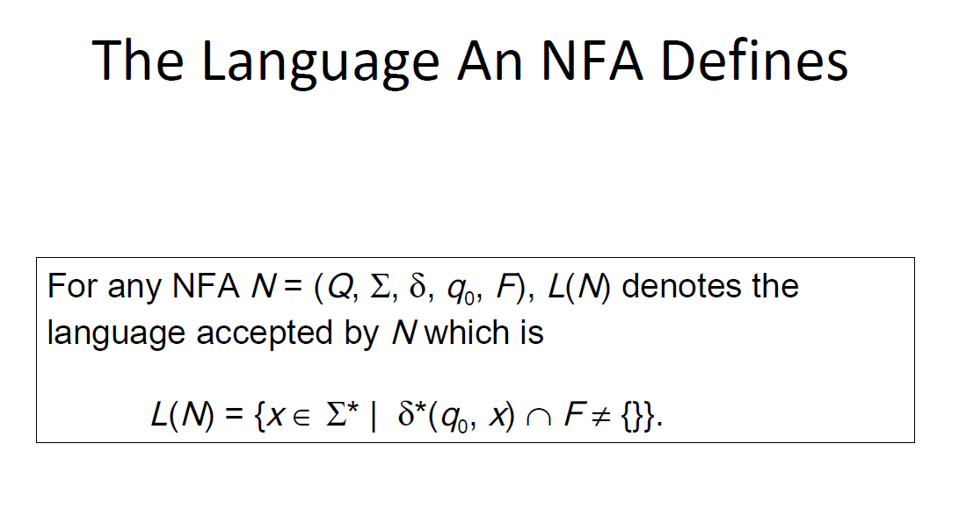

Slide 16
Thank You

